Slide 1
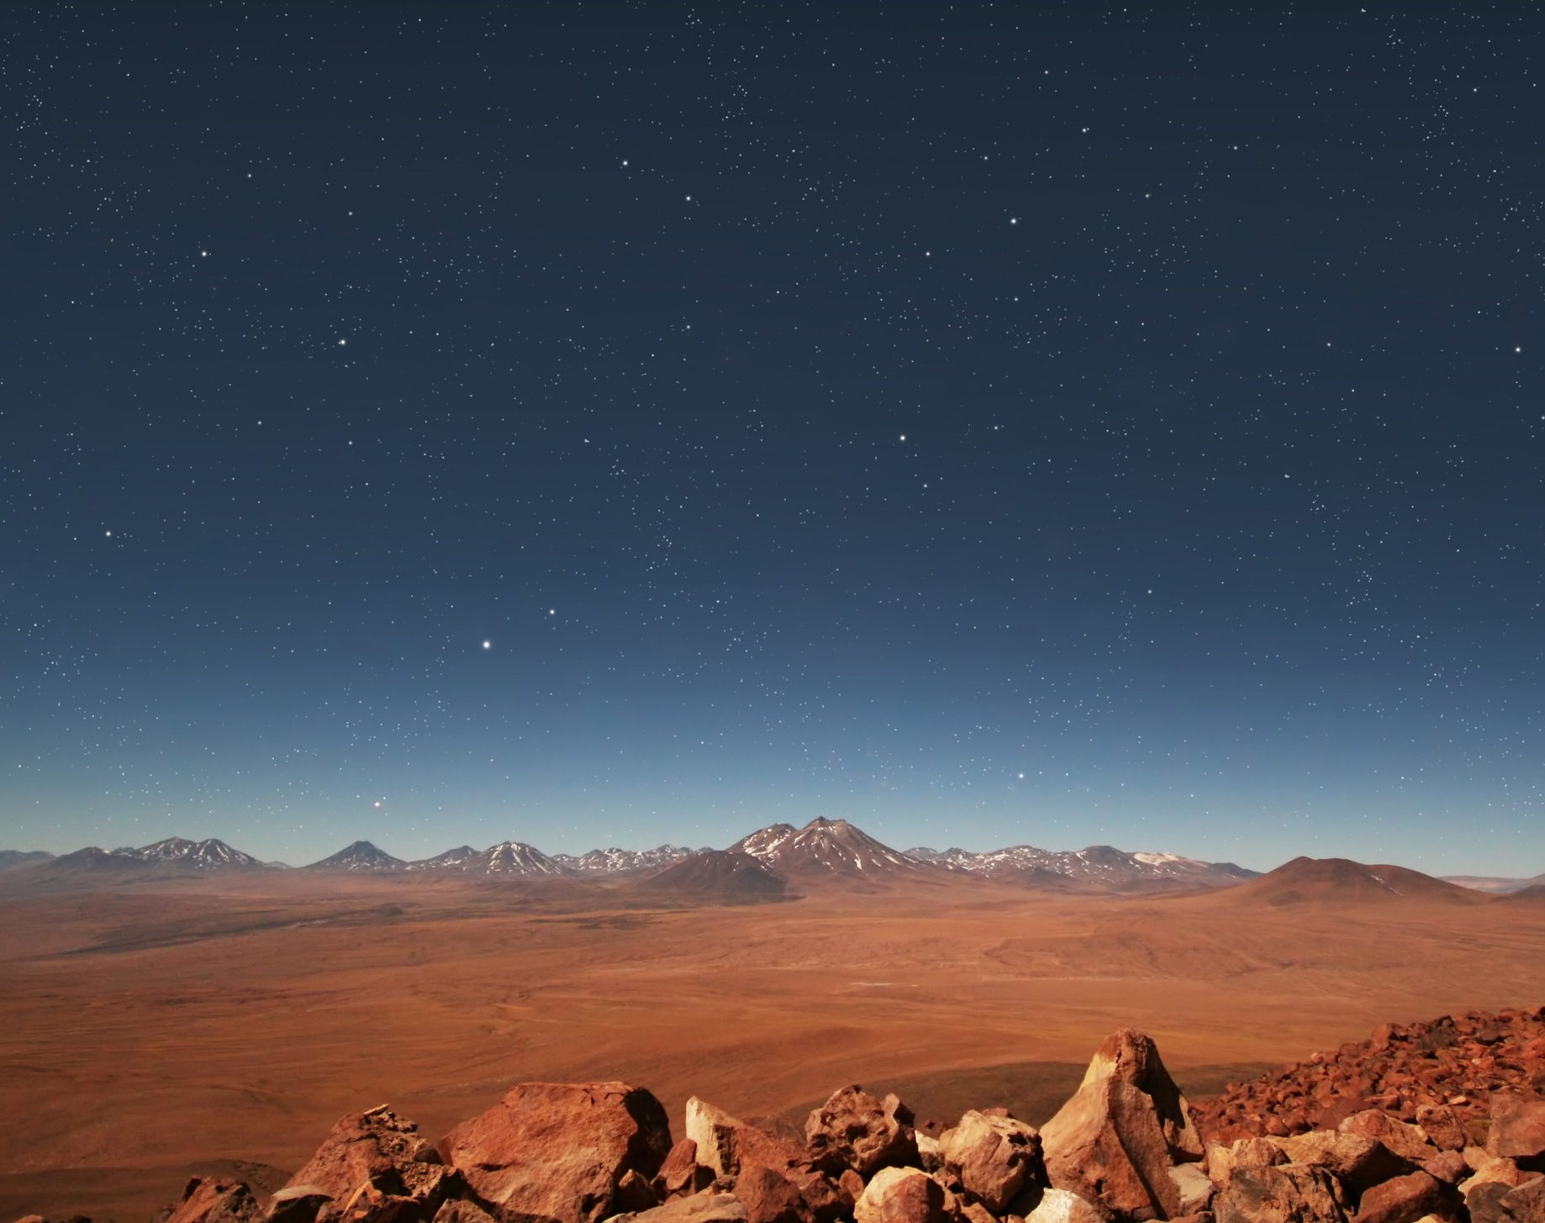
Psalm 8
How Majestic is Your Name in All the Earth

Slide 2
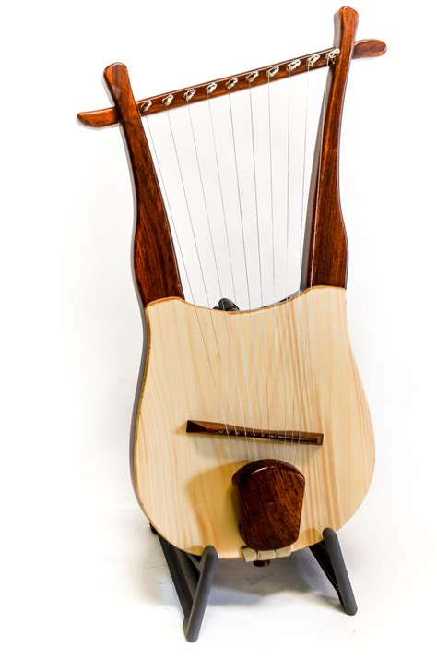
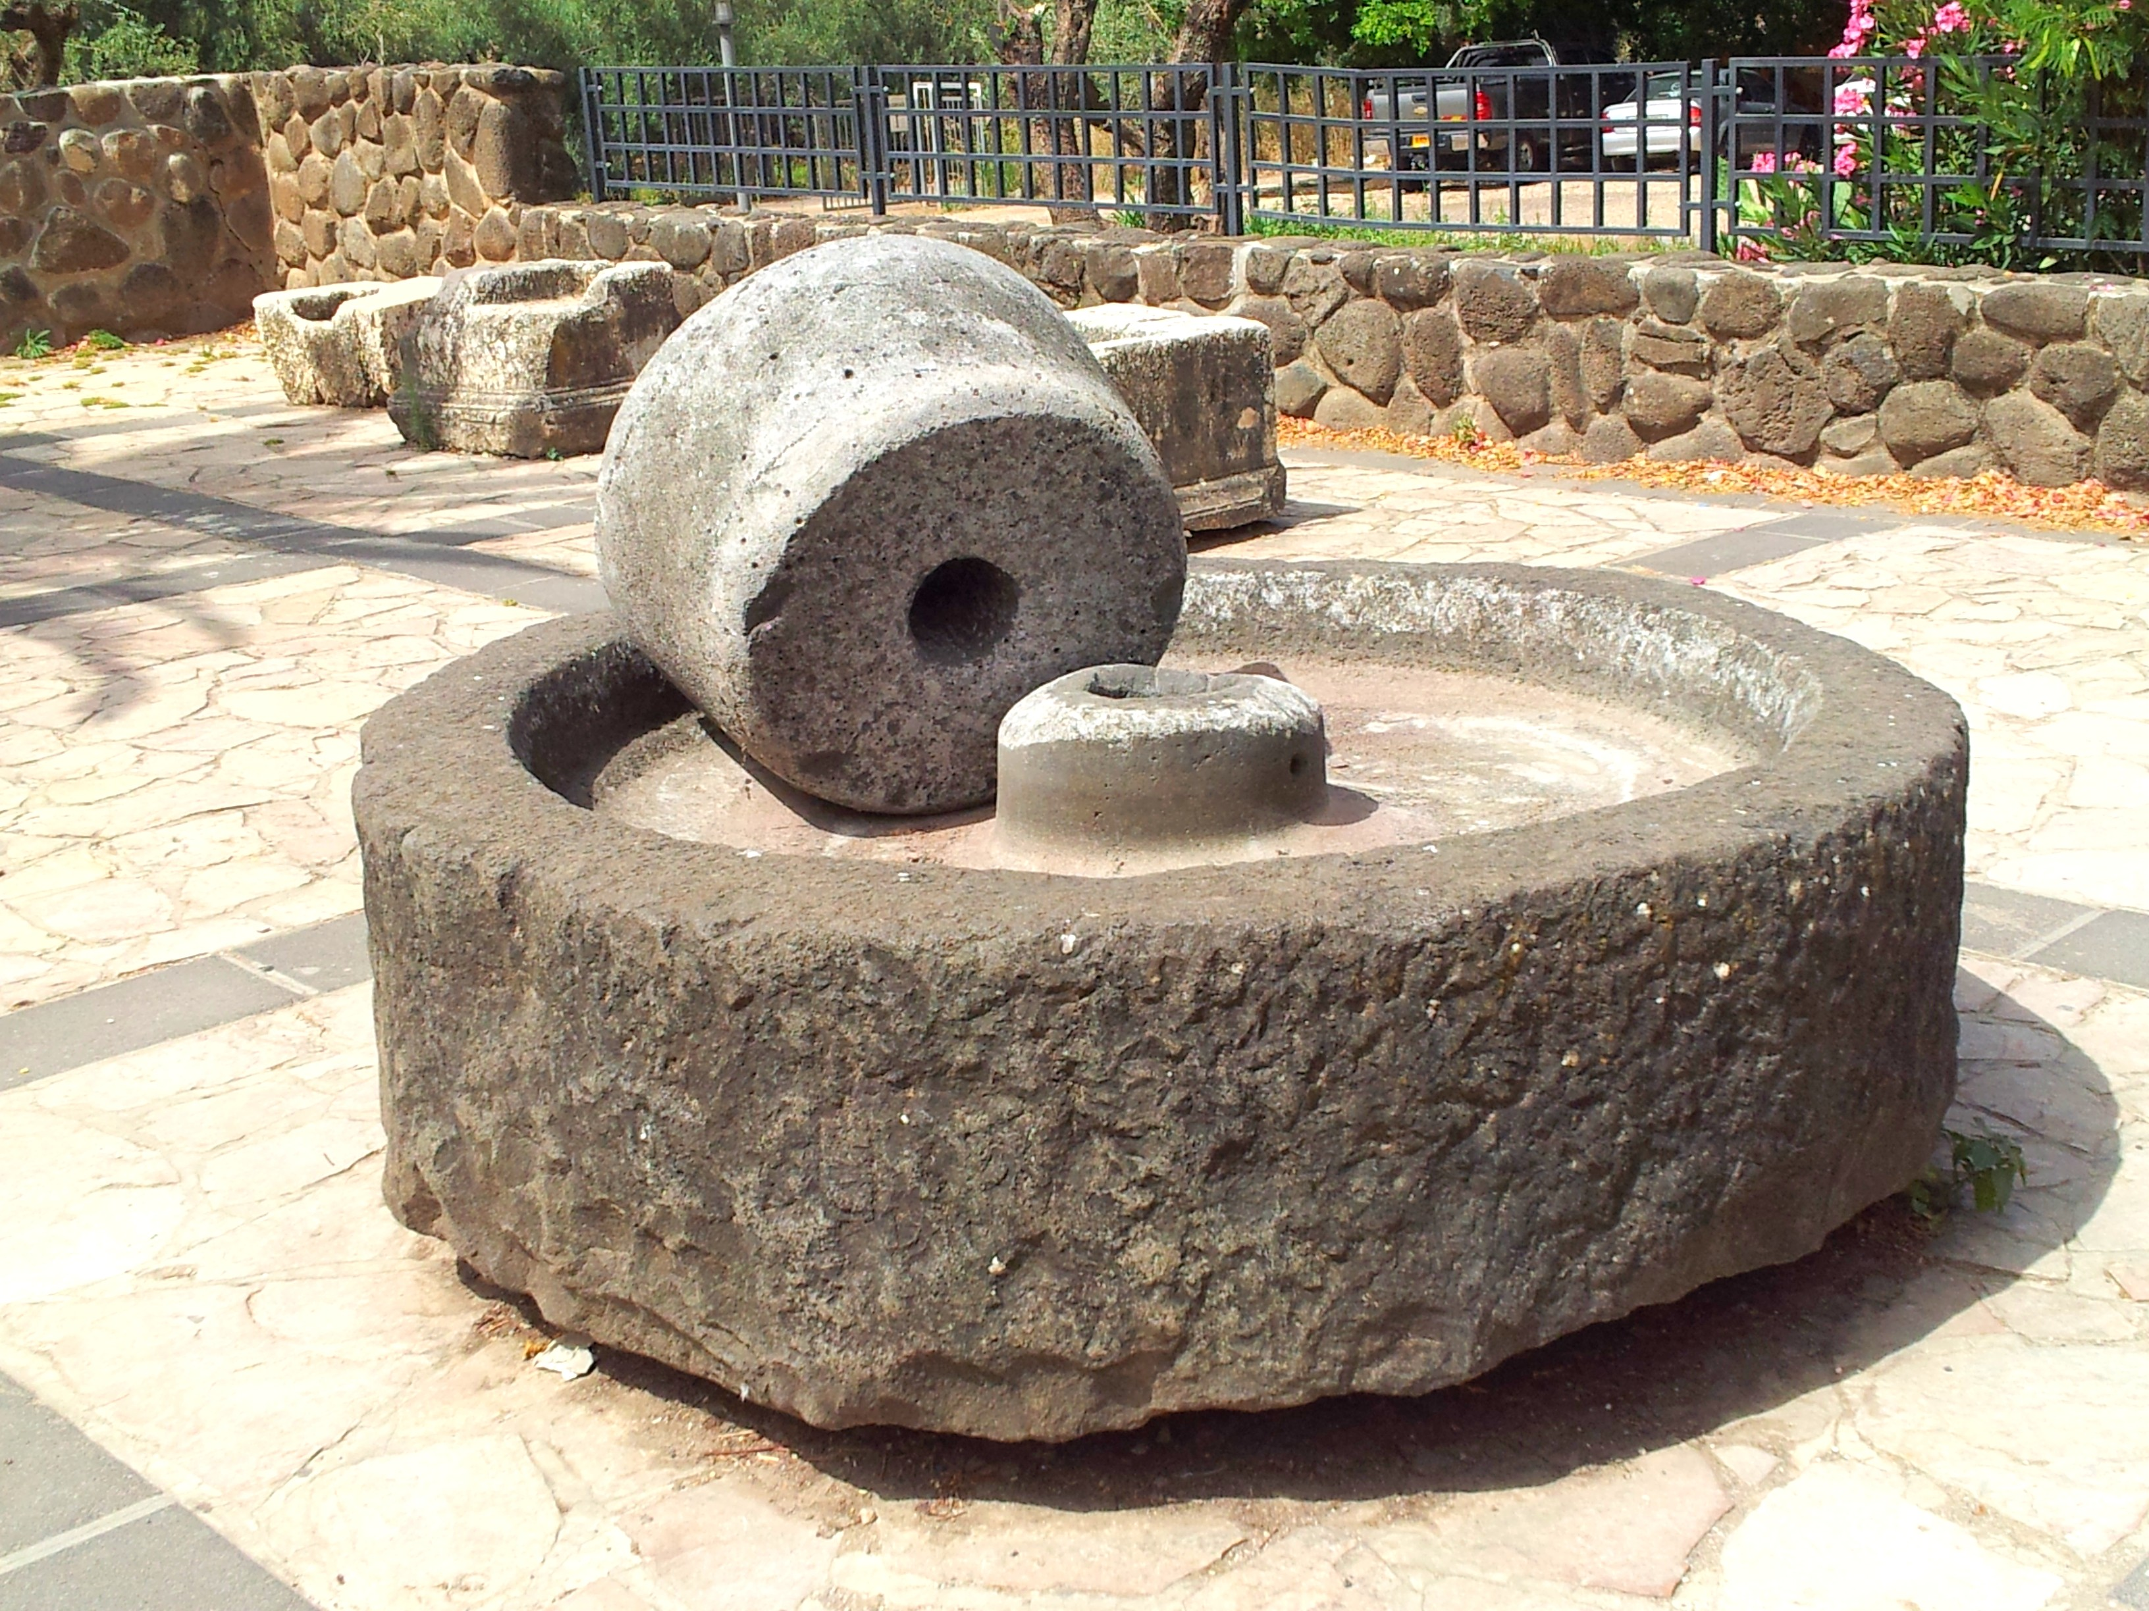

Slide 3
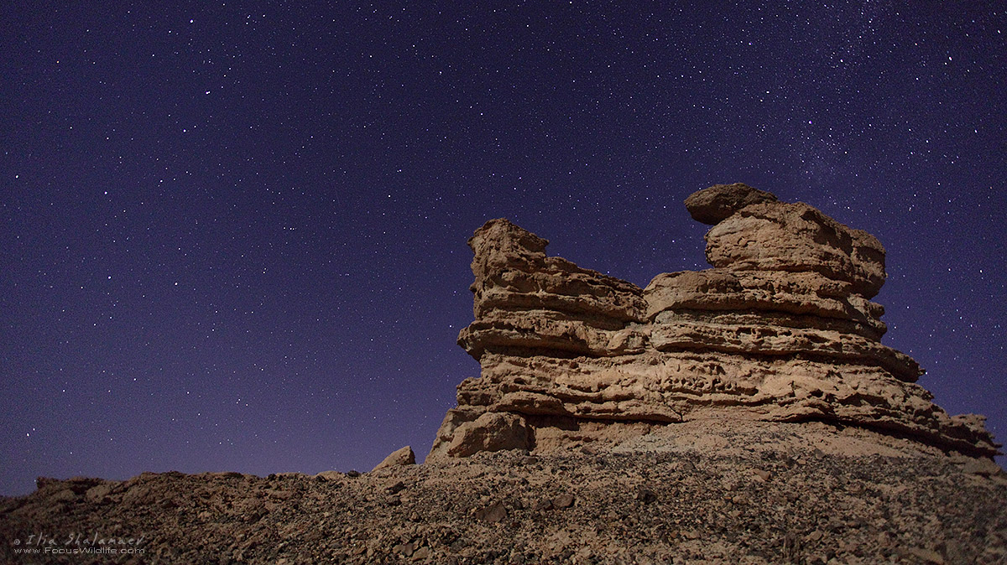

Slide 4
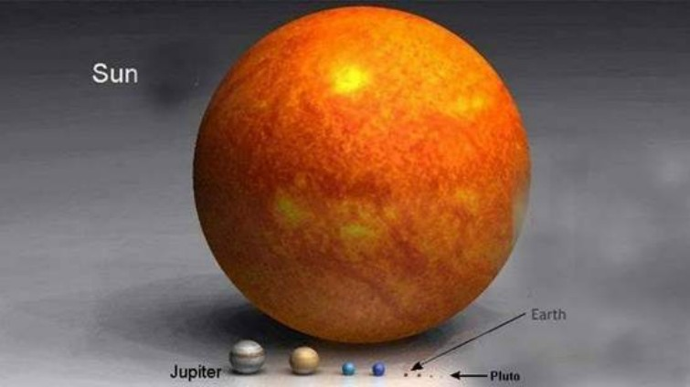
Notes:
This is something similar to what the psalmist was contemplating

Slide 5
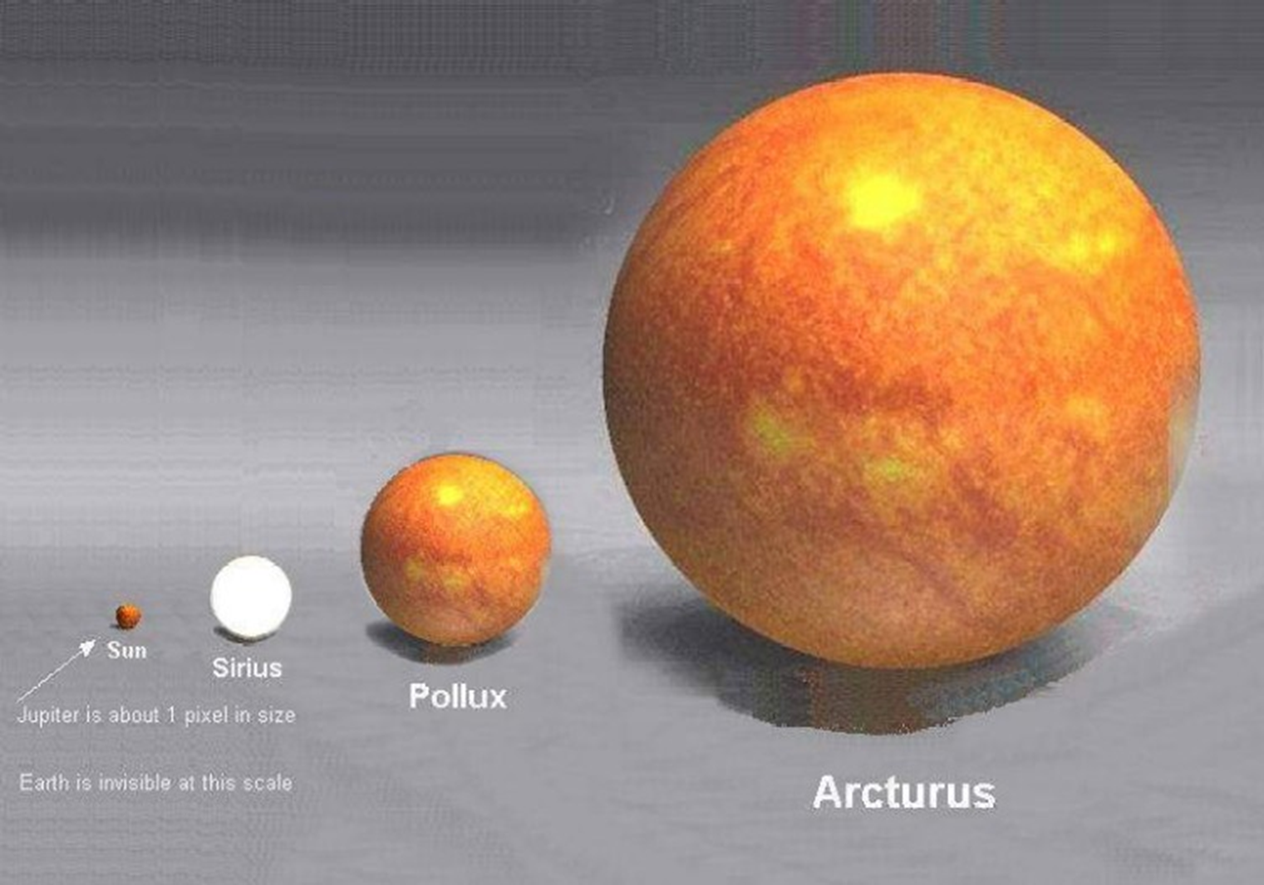

Slide 6
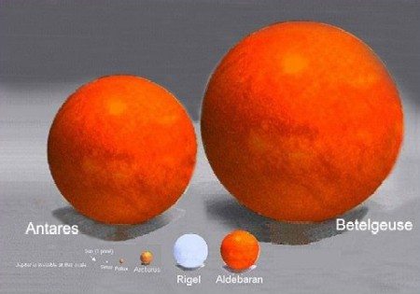
Notes:
This begins to show how insignificant we really are
Know this, and contemplating it should change the way we approach God

Slide 7
Psalm 8: Scriptural Reuse
1Corithians 15:25-27
Hebrews 2:6-9
Matthew 21:16
Job 7:17

Slide 8
Hearing Psalm 8
God stoops down
Discipline of contemplation
Theology of ecology (Creation)

