Slide 1
Do not be Matthew Anxious? 6:24-34

Slide 3
Anxiety and Money
Mt 6:24 “No one can serve two masters, for either he will hate the one and love the other, or he will be devoted to the one and despise the other. You cannot serve God and money. 25 “Therefore I tell you, do not be anxious about your life, …

Slide 4
Anxiety and Money
Mt 6:24 “No one can serve two masters, for either he will hate the one and love the other, or he will be devoted to the one and despise the other. You cannot serve God and money. 25 “Therefore I tell you, do not be anxious about your life, …
1 Tim 6: 10 For the love of money is a root of all kinds of evils. It is through this craving that some have wandered away from the faith and pierced themselves with many pangs.

Slide 5
Matthew 6
Mt 6:26 Look at the birds of the air: they neither sow nor reap nor gather into barns, and yet your heavenly Father feeds them. Are you not of more value than they? 27 And which of you by being anxious can add a single hour to his span of life? 28 And why are you anxious about clothing? Consider the lilies of the field, how they grow: they neither toil nor spin, 29 yet I tell you, even Solomon in all his glory was not arrayed like one of these. 30 But if God so clothes the grass of the field, which today is alive and tomorrow is thrown into the oven, will he not much more clothe you, O you of little faith? … 32 …and your heavenly Father knows that you need them all.

Slide 6
See
Mt 6:26 Look at the birds of the air: they neither sow nor reap nor gather into barns, and yet your heavenly Father feeds them. Are you not of more value than they? 27 And which of you by being anxious can add a single hour to his span of life? 28 And why are you anxious about clothing? Consider the lilies of the field, how they grow: they neither toil nor spin, 29 yet I tell you, even Solomon in all his glory was not arrayed like one of these. 30 But if God so clothes the grass of the field, which today is alive and tomorrow is thrown into the oven, will he not much more clothe you, O you of little faith? … 32 …and your heavenly Father knows that you need them all.

Slide 7
See
Mt 6:26 Look at the birds of the air: they neither sow nor reap nor gather into barns, and yet your heavenly Father feeds them. Are you not of more value than they? 27 And which of you by being anxious can add a single hour to his span of life? 28 And why are you anxious about clothing? Consider the lilies of the field, how they grow: they neither toil nor spin, 29 yet I tell you, even Solomon in all his glory was not arrayed like one of these. 30 But if God so clothes the grass of the field, which today is alive and tomorrow is thrown into the oven, will he not much more clothe you, O you of little faith? … 32 …and your heavenly Father knows that you need them all.

Slide 8
See
Mt 6:26 Look at the birds of the air: they neither sow nor reap nor gather into barns, and yet your heavenly Father feeds them. Are you not of more value than they? 27 And which of you by being anxious can add a single hour to his span of life? 28 And why are you anxious about clothing? Consider the lilies of the field, how they grow: they neither toil nor spin, 29 yet I tell you, even Solomon in all his glory was not arrayed like one of these. 30 But if God so clothes the grass of the field, which today is alive and tomorrow is thrown into the oven, will he not much more clothe you, O you of little faith? … 32 …and your heavenly Father knows that you need them all.

Slide 9
Consider
Mt 6:25 “Therefore I tell you, do not be anxious about your life, what you will eat or what you will drink, nor about your body, what you will put on. Is not life more than food, and the body more than clothing? … 33 But seek first the kingdom of God and his righteousness, and all these things will be added to you. 34 “Therefore do not be anxious about tomorrow, for tomorrow will be anxious for itself. Sufficient for the day is its own trouble.

Slide 10
Consider
Mt 6:25 “Therefore I tell you, do not be anxious about your life, what you will eat or what you will drink, nor about your body, what you will put on. Is not life more than food, and the body more than clothing? … 33 But seek first the kingdom of God and his righteousness, and all these things will be added to you. 34 “Therefore do not be anxious about tomorrow, for tomorrow will be anxious for itself. Sufficient for the day is its own trouble.

Slide 12
Luke 1:38 And Mary said, “Behold, I am the servant of the Lord; let it be to me according to your word.”

Slide 13
Consider
Mt 6:25 “Therefore I tell you, do not be anxious about your life, what you will eat or what you will drink, nor about your body, what you will put on. Is not life more than food, and the body more than clothing? … 33 But seek first the kingdom of God and his righteousness, and all these things will be added to you. 34 Therefore do not be anxious about tomorrow, for tomorrow will be anxious for itself. Sufficient for the day is its own trouble.”

Slide 14
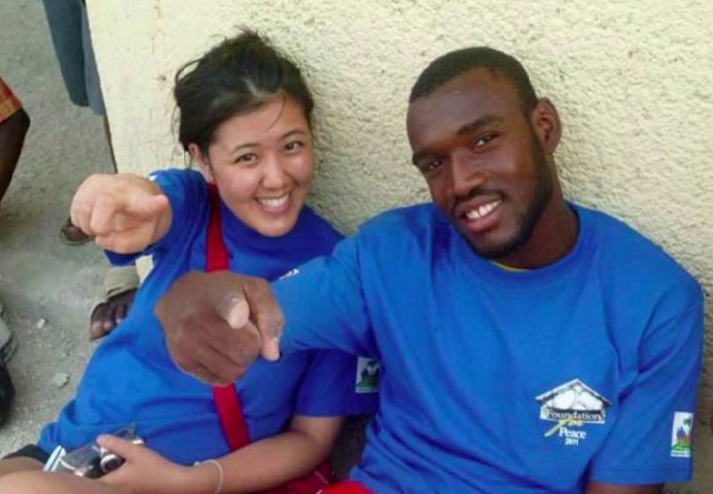
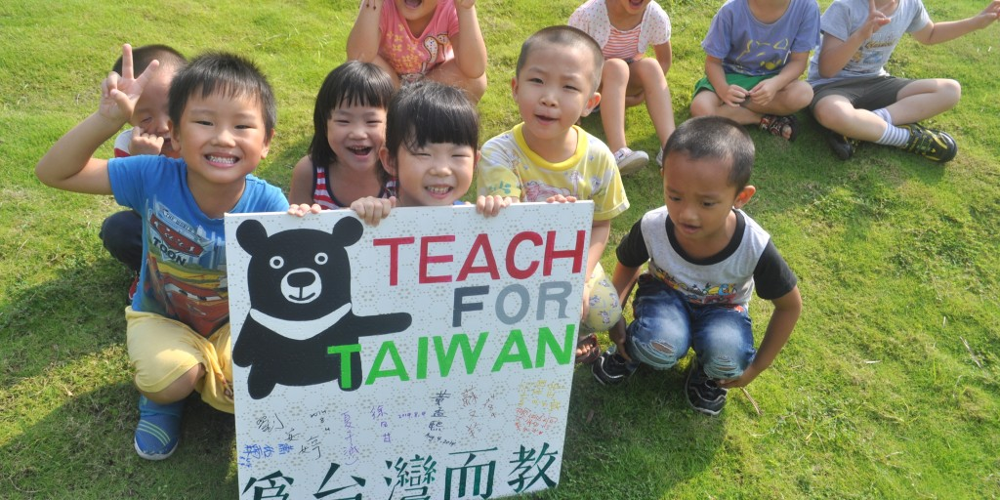

Slide 15
Being Anxious?
Look …
Consider …

