Slide 1
Overcoming Sin
Psalm 51

Slide 2
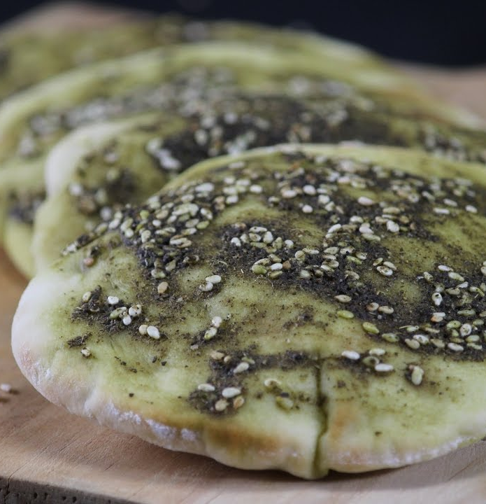
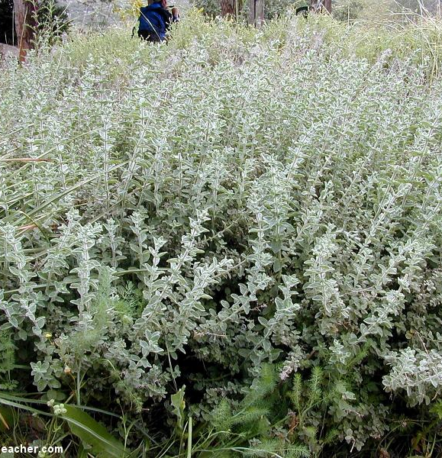

Slide 3
Navigating Our Way through Sin
We can overcome
Recognize mercy and grace
Fully depend on God
Confess sin
Broken spirit required
Don’t wait to get caught

